Slide 1



Slide 2
PART I
My Top Movies watched in 2023

Slide 3


Oppenheimer
The world forever changes.
2023 • Directed by Christopher Nolan

Slide 4


Killers of the Flower Moon
Greed is an animal that hungers for blood.
2023 • Directed by Martin Scorsese

Slide 5


John Wick: Chapter 4
No way back, one way out.
2023 • Directed by Chad Stahelski

Slide 6
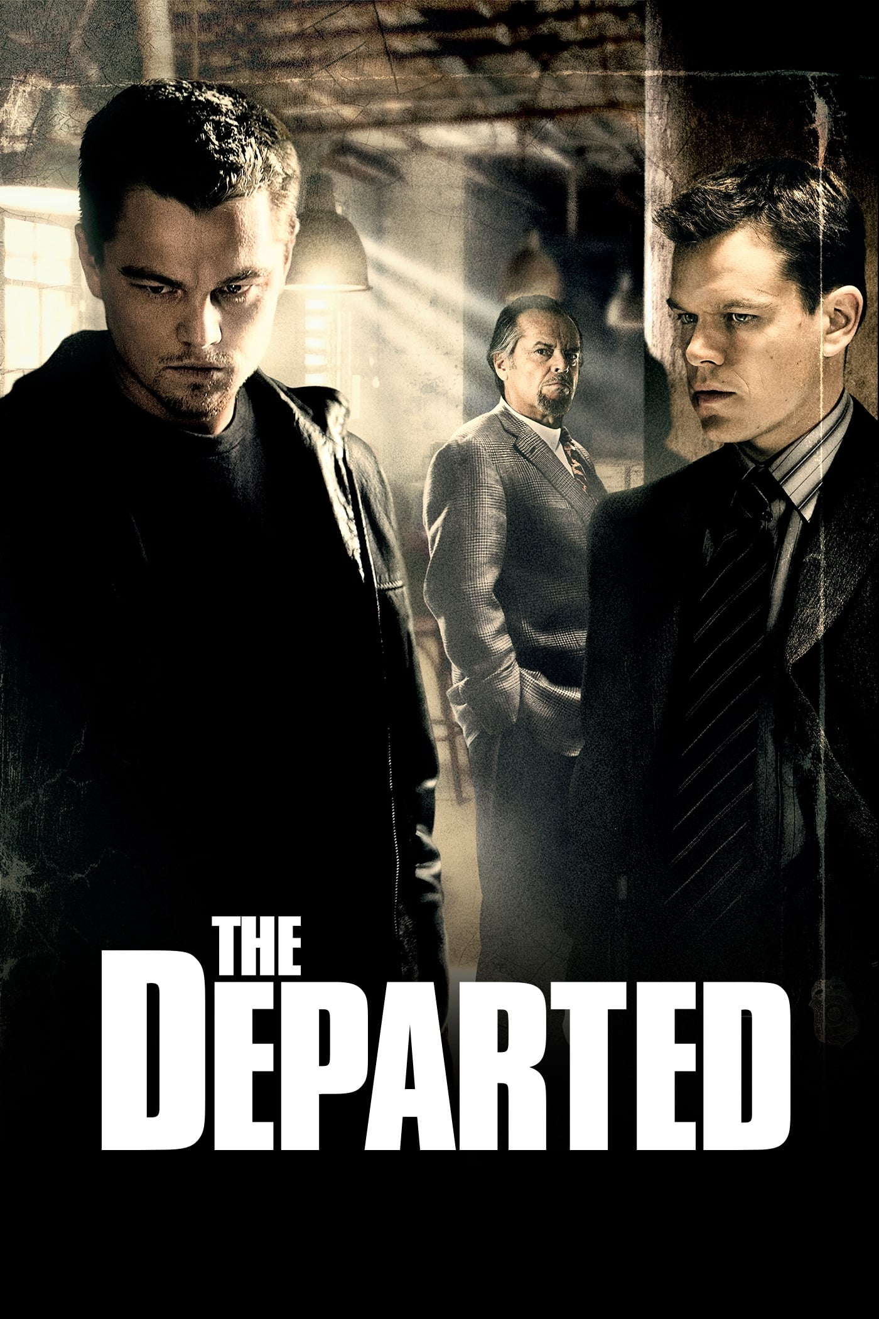

The Departed
Lies. Betrayal. Sacrifice. How far will you take it?
2006 • Directed by Martin Scorsese

Slide 7
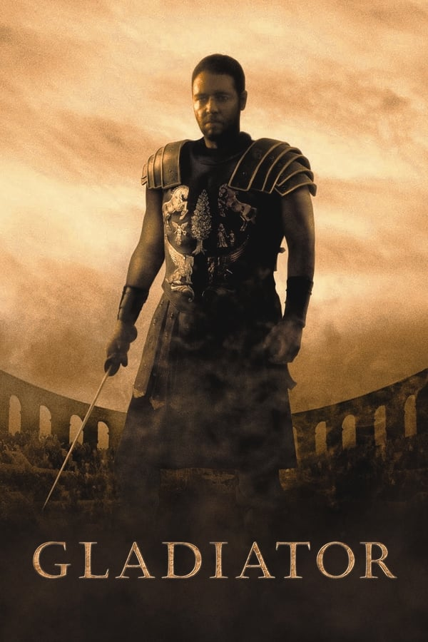

Gladiator
A hero will rise.
2000 • Directed by Ridley Scott

Slide 8


The Prestige
Are You Watching Closely?
2006 • Directed by Christopher Nolan

Slide 9


Schindler's List
Whoever saves one life, saves the world entire.
1993 • Directed by Steven Spielberg

Slide 10


Fight Club
Mischief. Mayhem. Soap.
1999 • Directed by David Fincher

Slide 11
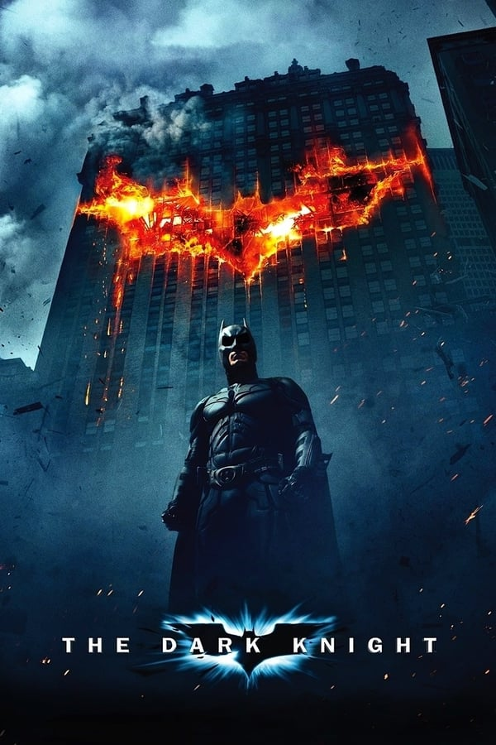

The Dark Knight
Welcome to a world without rules.
2008 • Directed by Christopher Nolan

Slide 12
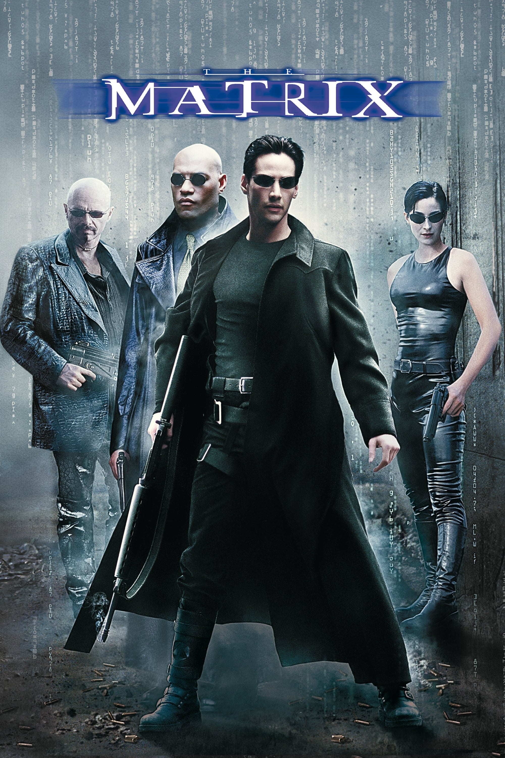

The Matrix
The fight for the future begins.
1999 • Directed by Lilly & Lana Wachowski

Slide 14

PART II
My Top Series watched in 2023

Slide 15

Silo - Season 1
The truth will surface.
2023 • Created by Graham Yost

Slide 16

The Mandalorian
Season 3
This is the Way.
2023 • Created by Jon Favreau

Slide 17

Death Note
The hunted becomes the hunter!
2006 - 2007 • Created by Tsugumi Ohba

Slide 18
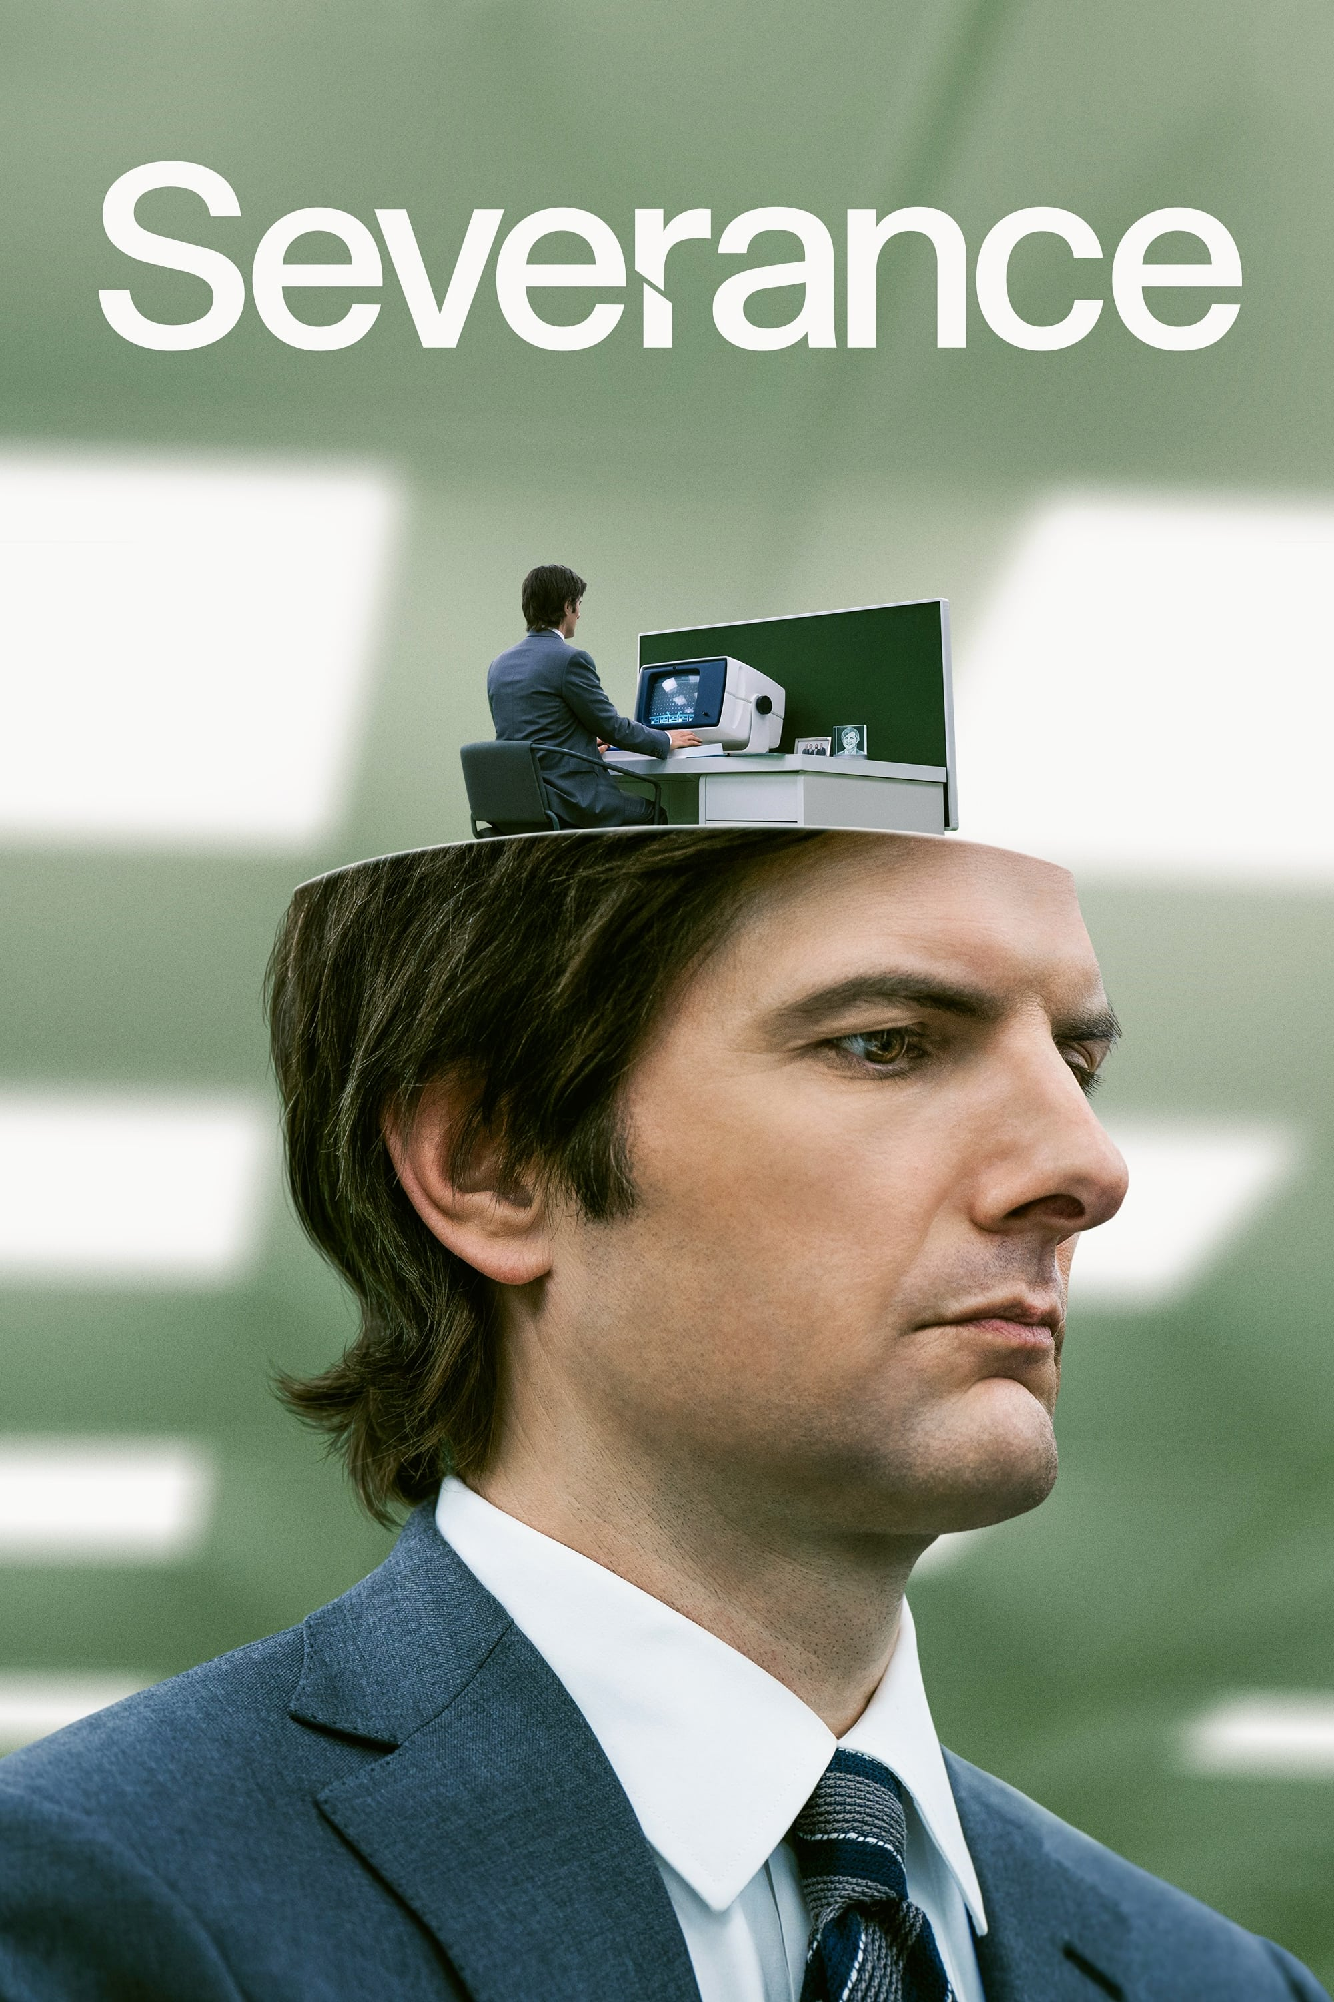
Severance - Season 1
We're all different people at work.
2022 • Created by Dan Erickson

Slide 19

The Last of Us - Season 1
When you're lost in the darkness, look for the light.
2023 • Created by Craig Mazin & Neil Druckmann

Slide 21

PART III
My Top Actors & Actresses in 2023

Slide 22
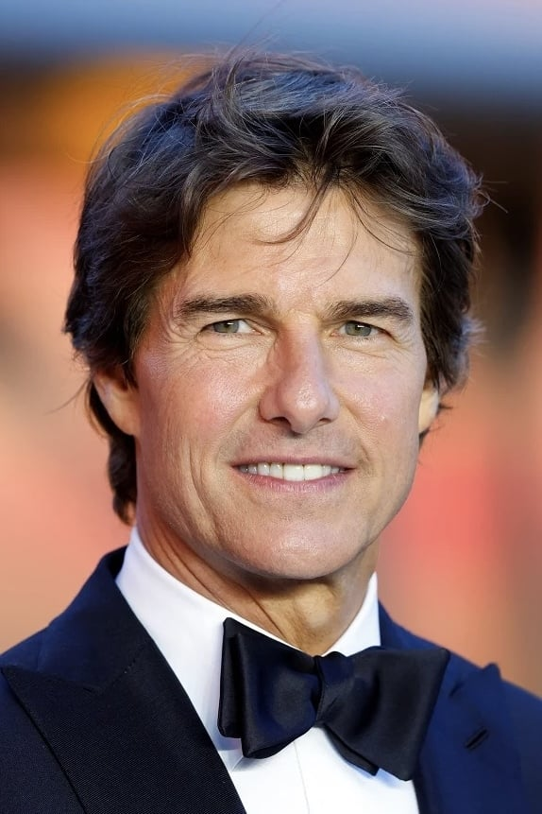
Tom Cruise
Watched in 2023:
Mission: Impossible - Dead Reckoning Part One (Ethan Hunt)
A Few Good Men (Lt. Daniel Kaffee)
Valkyrie (Claus Schenk Graf von Stauffenberg)
Jack Reacher: Never Go Back (Jack Reacher)
American Made (Barry Seal)
War of the Worlds (Ray Ferrier)

Slide 23
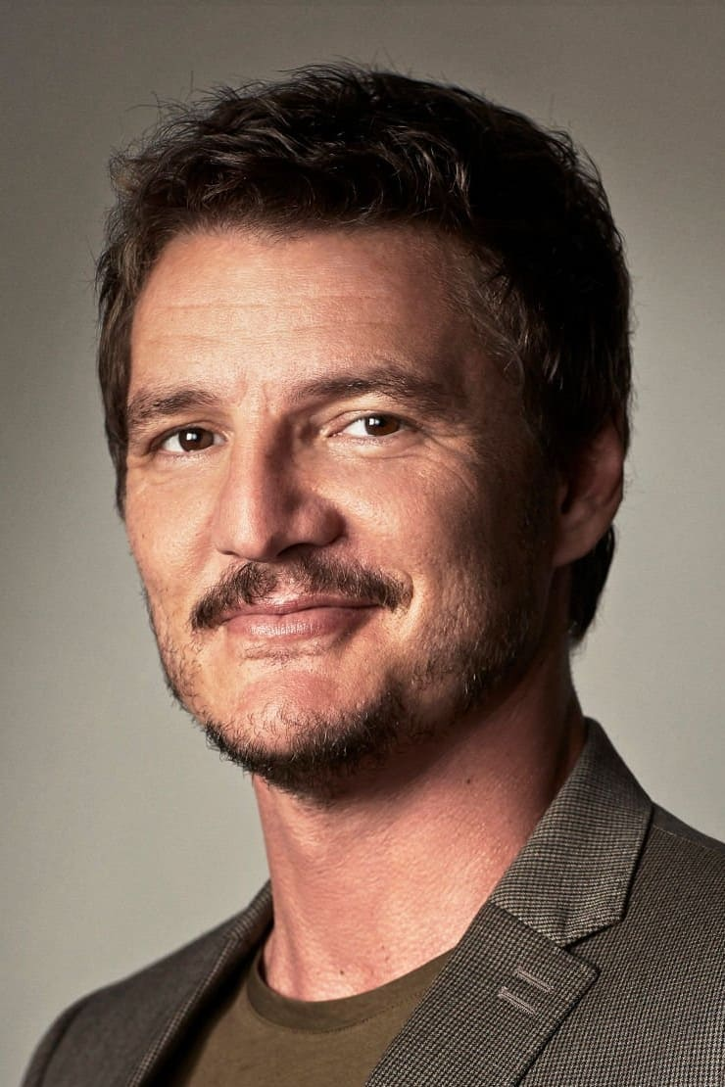
Pedro Pascal
Watched in 2023:
The Last of Us - Season 1 (Joel Miller)
The Mandalorian - Season 3
(Din Djarin, The Mandalorian)
The Equalizer 2 (Dave York)
The Unbearable Weight of Massive Talent
(Javi Gutierrez)
The Great Wall (Pero Tovar)
Strange Way of Life (Silva)

Slide 24
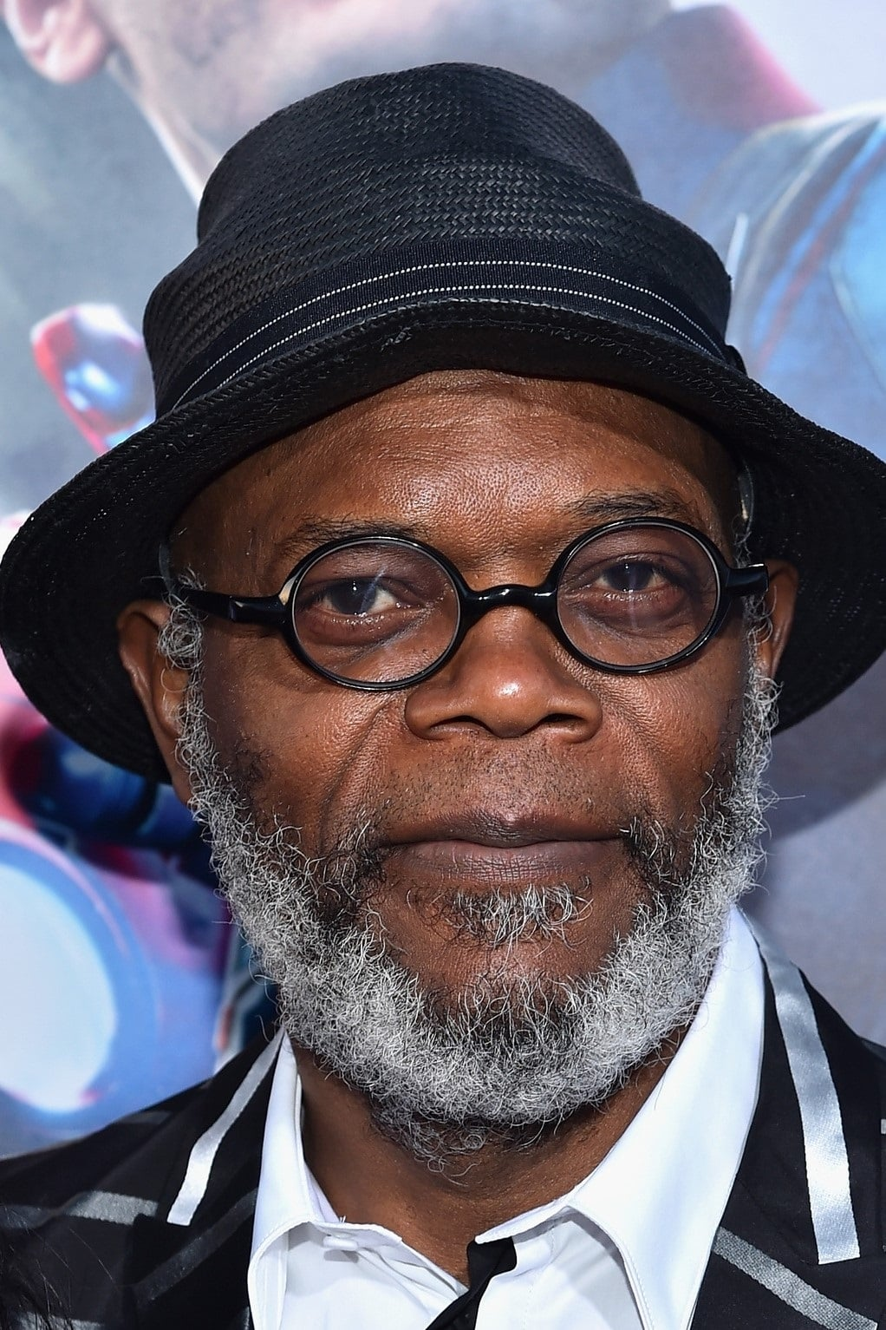
Samuel L. Jackson
Watched in 2023:
The Hateful Eight (Major Marquis Warren)
Jackie Brown (Ordell Robbie)
Django Unchained (Stephen)
True Romance (Big Don)
Star Wars Prelogy (Mace Windu)
Glass (Elijah Price, Mr. Glass)
Secret Invasion (Nick Fury)
Kill Bill: Vol. 2 (Rufus)

Slide 25
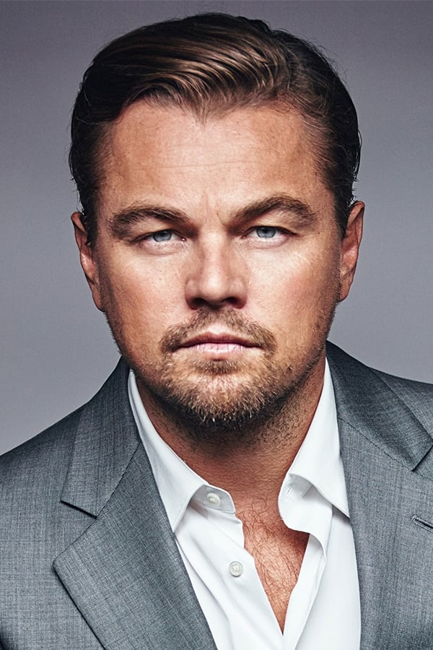
Leonardo DiCaprio
Watched in 2023:
The Departed (William "Billy" Costigan Jr.)
Killers of the Flower Moon (Ernest Burkhart)
Django Unchained (Calvin J. Candie)
Shutter Island (Teddy Daniels)

Slide 26

Helena Bonham Carter
Watched in 2023:
Fight Club (Marla Singer)
Harry Potter 5, 6, 7 Part 1 and 2
(Bellatrix Lestrange)
Big Fish (Jenny, The Witch)
The King's Speech (Queen Elizabeth)
Planet of the Apes (Ari)
Les Misérables (Madame Thénardier)
Ocean's Eight (Rose Weil)

Slide 27
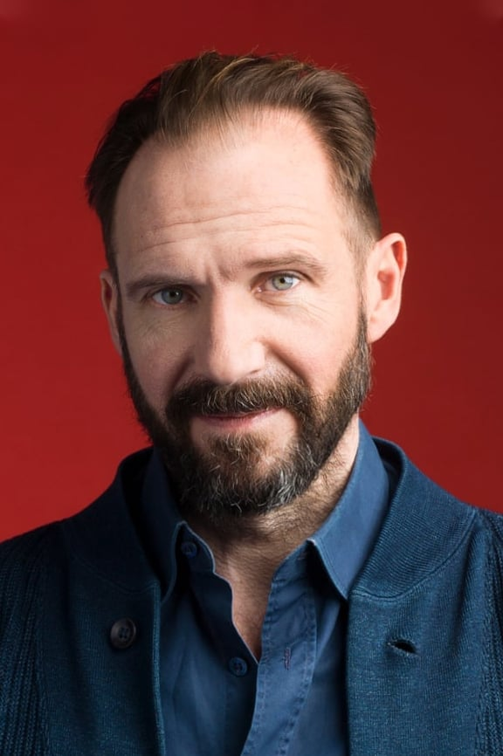
Ralph Fiennes
Watched in 2023:
Schindler's List (Amon Goeth)
Harry Potter 4, 5, 7 Part 1 and 2 (Lord Voldemort)
The Grand Budapest Hotel (Monsieur Gustave H.)
The Menu (Chef Slowik)
Official Secrets (Ben Emmerson)
Clash of the Titans (Hades)
Wrath of the Titans (Hades)

Slide 28
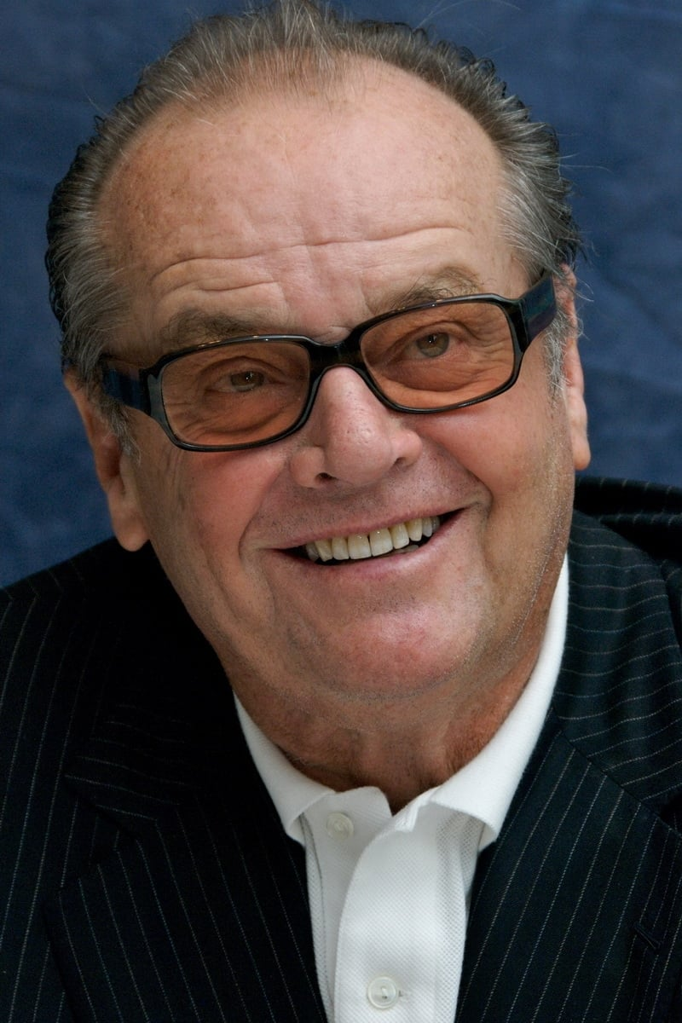
Jack Nicholson
Watched in 2023:
The Departed (Francis 'Frank' Costello)
One Flew Over the Cuckoo's Nest
(Randle Patrick McMurphy)
Batman (Jack Napier, The Joker)
A Few Good Men (Col. Nathan R. Jessep)
Chinatown (J.J. 'Jake' Gittes)
The Bucket List (Edward Periman Cole)
Anger Management (Dr. Buddy Rydell)

Slide 29
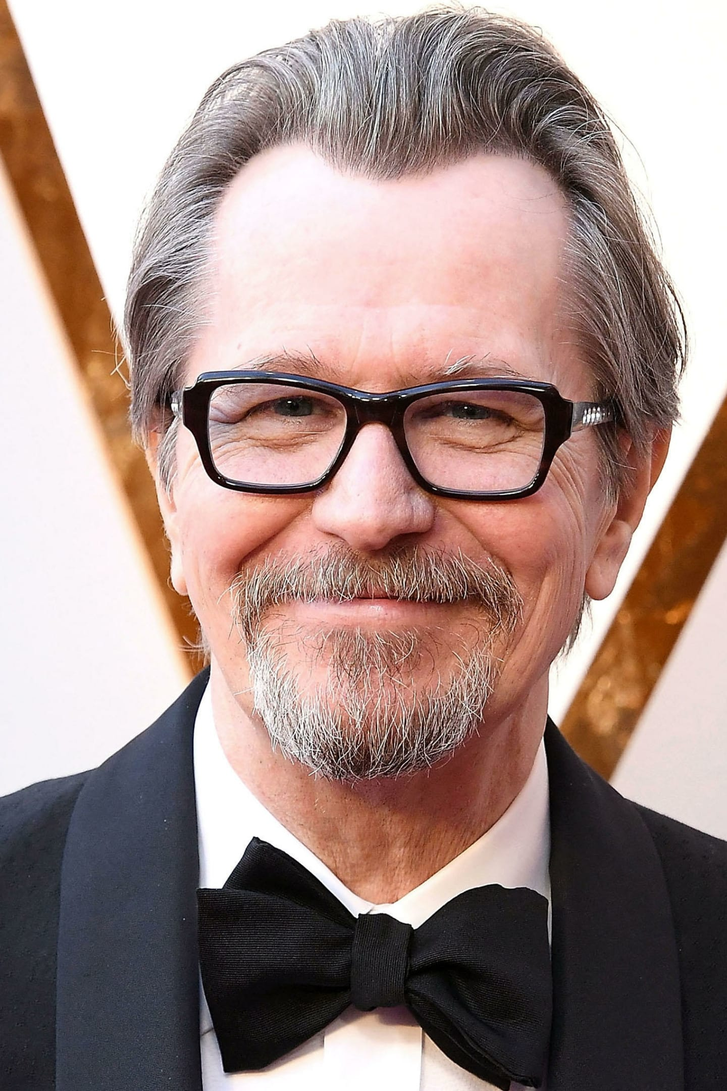
Gary Oldman
Watched in 2023:
Batman Begins (James Gordon)
The Dark Knight (James Gordon)
The Dark Knight Rises (James Gordon)
Darkest Hour (Winston Churchill)
Harry Potter and the Prisoner of Azkaban (Sirius Black)
Harry Potter and the Order of the Phoenix (Sirius Black)
Air Force One (Ivan Korshunov)
Tinker Tailor Soldier Spy (George Smiley)
Dawn of the Planet of the Apes (Dreyfus)
True Romance (Drexl Spivey)
Oppenheimer (Harry Truman)

Slide 30
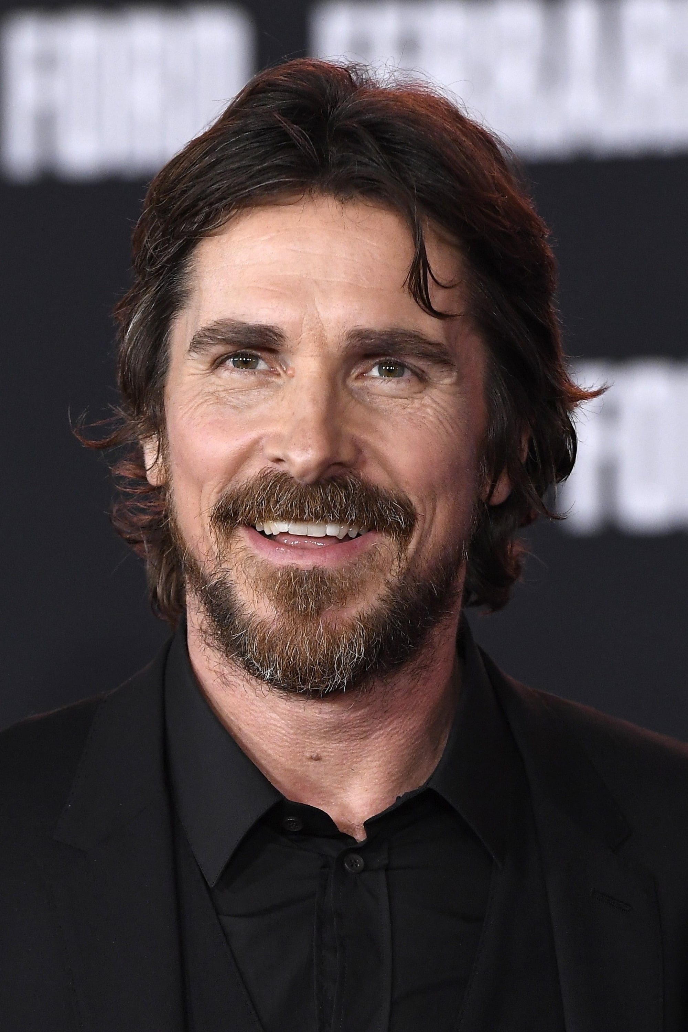
Christian Bale
Watched in 2023:
Batman Begins (Bruce Wayne, Batman)
The Dark Knight (Bruce Wayne, Batman)
The Dark Knight Rises (Bruce Wayne, Batman)
The Prestige (Alfred Borden)
American Psycho (Patrick Bateman)
Empire of the Sun (Jim)
The Machinist (Trevor Reznik)
Equilibrium (John Preston)
3:10 to Yuma (Dan Evans)
The Pale Blue Eye (Augustus Landor)
The Big Short (Michael Burry)

Slide 31
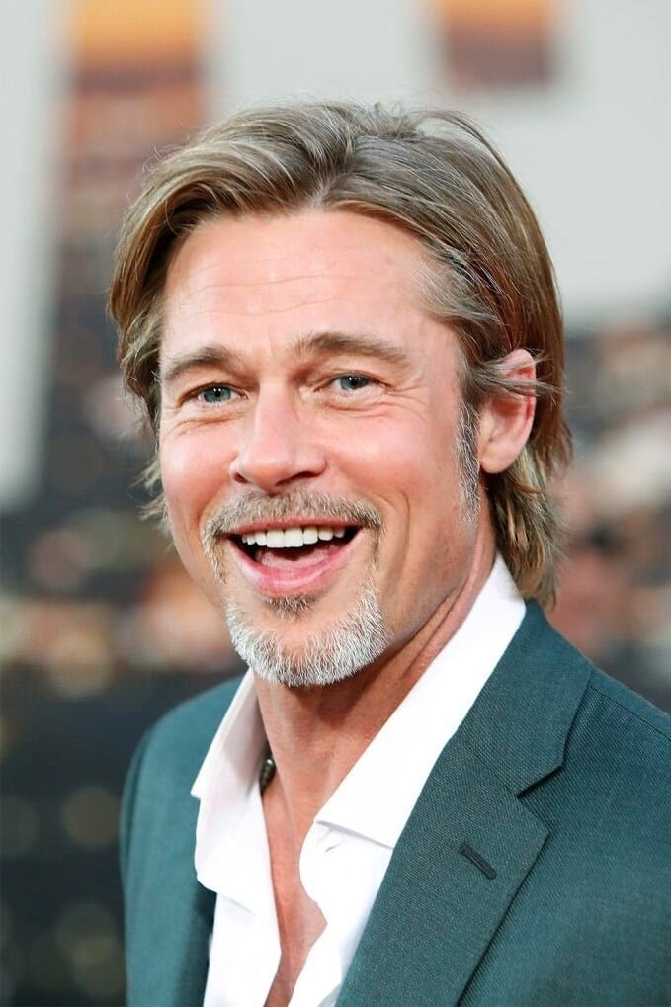
Brad Pitt
Watched in 2023:
Fight Club (Tyler Durden)
Se7en (Detective David Mills)
Twelve Monkeys (Jeffrey Goines)
Fury (Don 'Wardaddy' Collier)
The Curious Case of Benjamin Button (Benjamin Button)
Inglourious Basterds (First Lieutenant Aldo "The Apache" Raine)
Snatch (Mickey O'Neil)
Troy (Achilles)
World War Z (Gerry Lane)
Ocean's Eleven, Ocean's Twelve, Ocean's Thirteen (Rusty Ryan)
Spy Game (Tom Bishop)
Sleepers (Michael Sullivan)
True Romance (Floyd)
The Big Short (Ben Rickert)

Slide 33

PART IV
My Top Directors in 2023

Slide 34
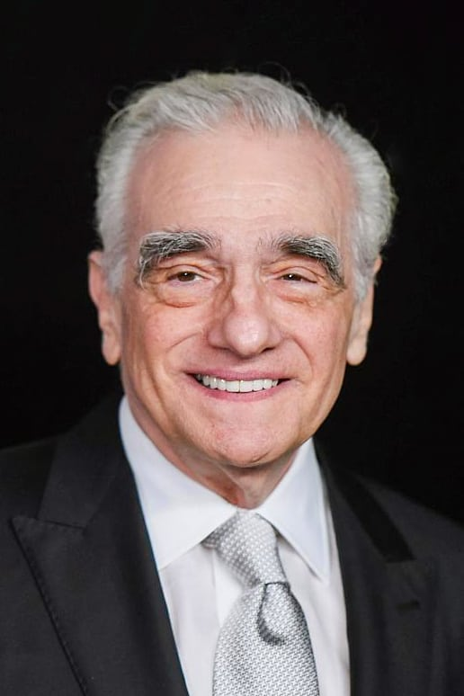
Martin Scorsese
Watched in 2023:
Killers of the Flower Moon
The Departed
Casino
Shutter Island
After Hours

Slide 35
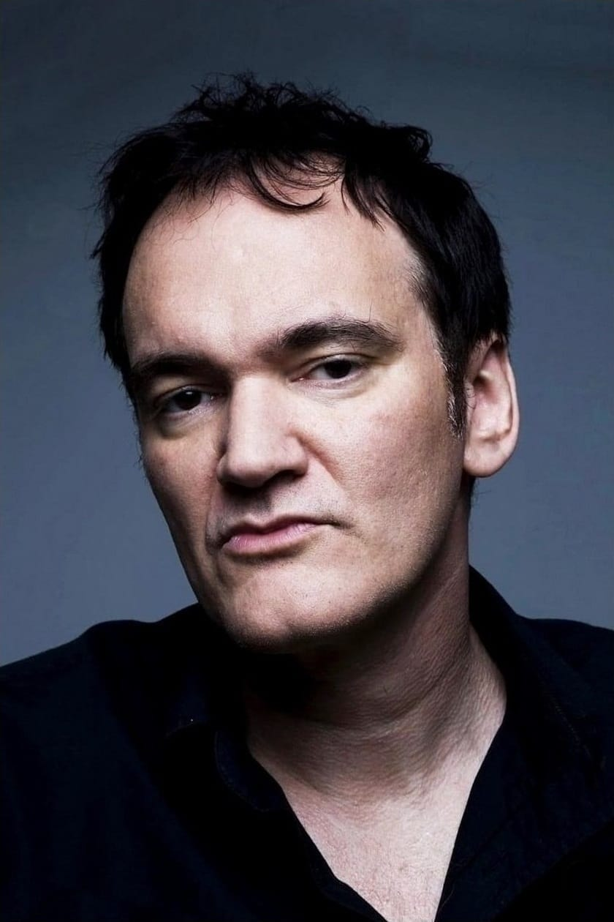
Quentin Tarantino
Watched in 2023:
Kill Bill: Vol. 1
Kill Bill: Vol. 2
Django Unchained
The Hateful Eight
Inglourious Basterds
Reservoir Dogs
Jackie Brown
True Romance (writing)

Slide 36
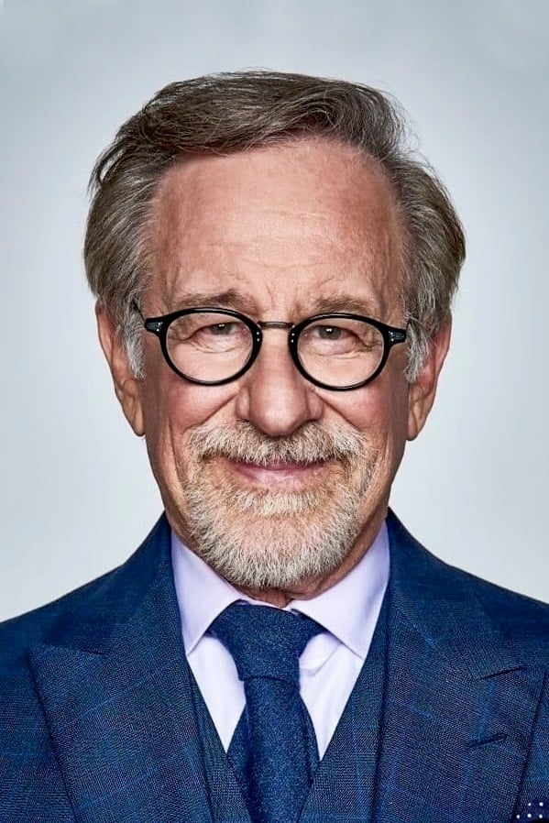
Steven Spielberg
Watched in 2023:
Schindler's List
Ready Player One
Raiders of the Lost Ark
Indiana Jones and the Last Crusade
Indiana Jones and the Kingdom of the Crystal Skull
Empire of the Sun
Hook
War of the Worlds

Slide 37
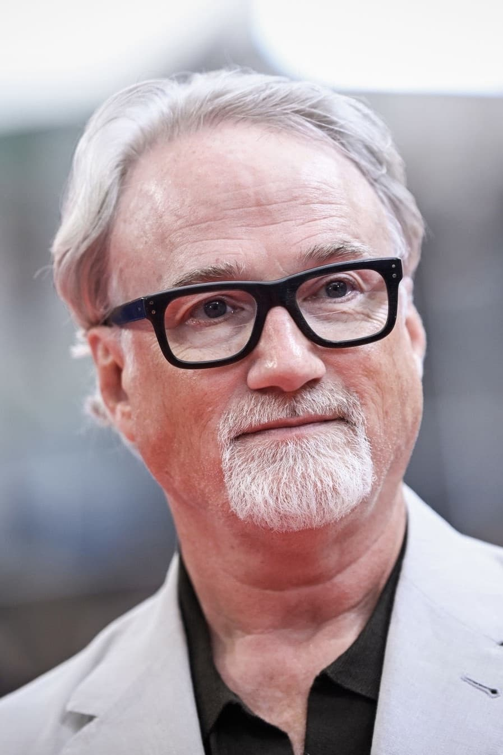
David Fincher
Watched in 2023:
Fight Club
Se7en
The Game
The Curious Case of Benjamin Button
The Social Network
Zodiac
Gone Girl
The Girl with the Dragon Tattoo

Slide 38
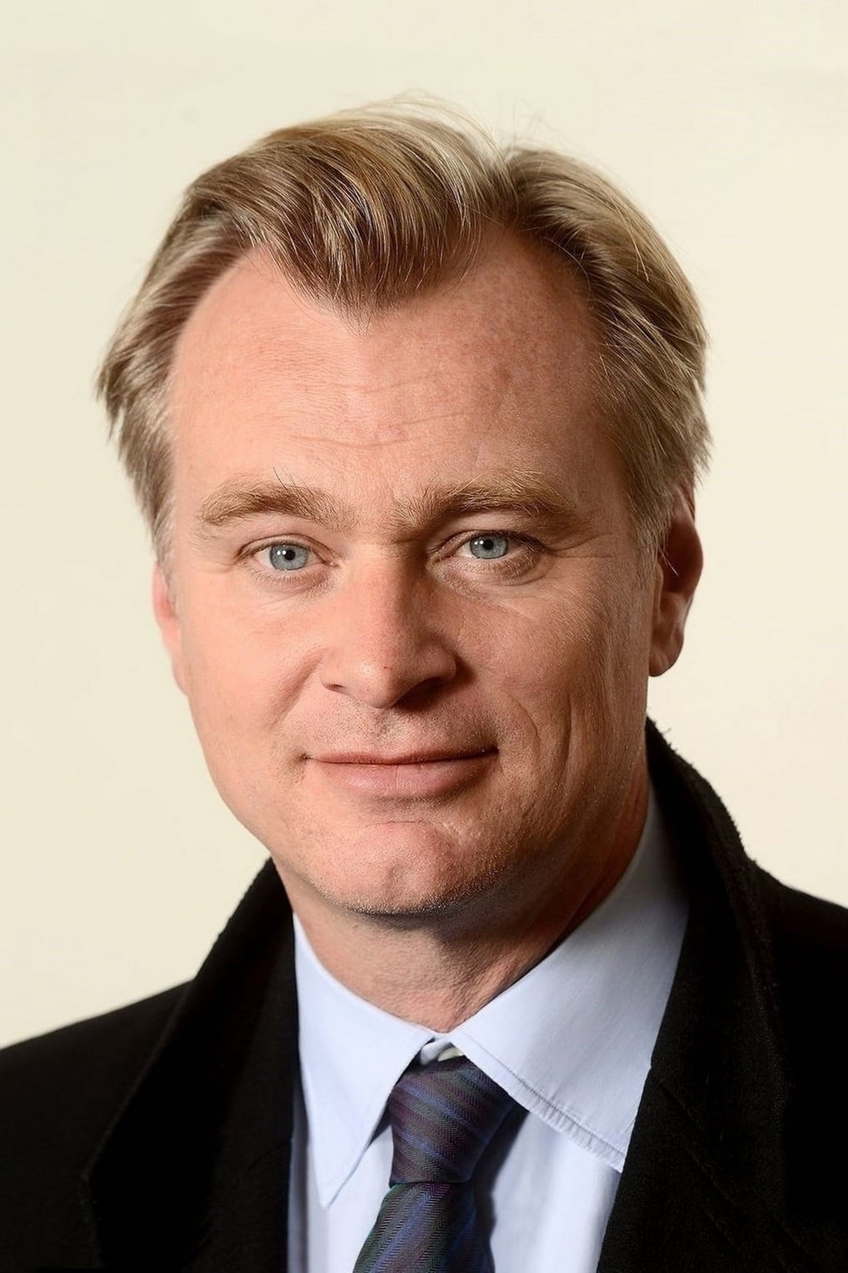
Christopher Nolan
Watched in 2023:
Batman Begins
The Dark Knight
The Dark Knight Rises
The Prestige
Oppenheimer
Memento
Insomnia
Tenet
Dunkirk

Slide 40





The pictures of movies, series and artists, informations come from The Movie Database.
The background image and those of the medals come from Dreamstime.
Credits
Music
from Bribes for Beggars
by Edgar Hopp.
The heading image on the first slide was created with FlamingText.
Thanks to Trakt for the management (listing) and
statistical reviews.

Slide 41
Thanks for all movies and series
also those that have not been classified in these tops.
See you next year for My CineTop 2024 !

